Slide 1
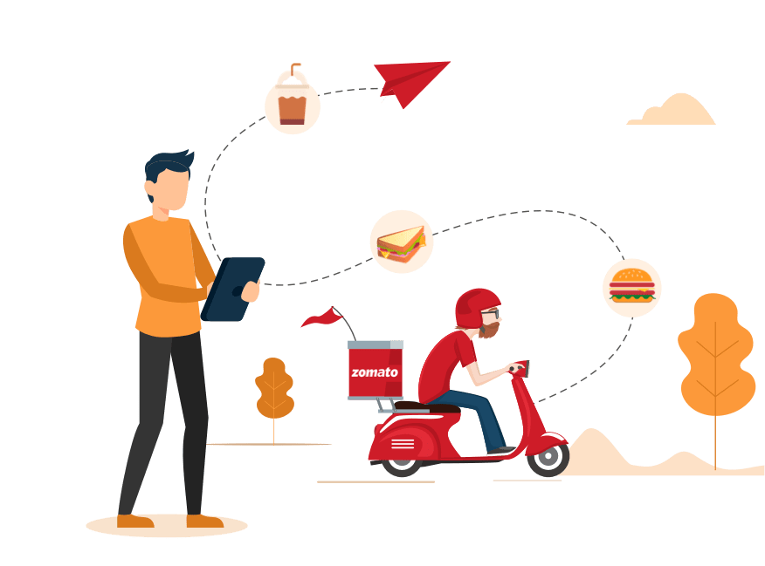
aXess Labs – Design Thinking
Multi vendor order in a single go.

Slide 2
TEAM NIT JALANDHAR
Bhanu Pratap – 1636460
Aditya Manchanda – 1636461
Ishan Sethi – 1636462
Aviral Gupta – 1636463
Hiten Sharma – 1636464

Slide 3
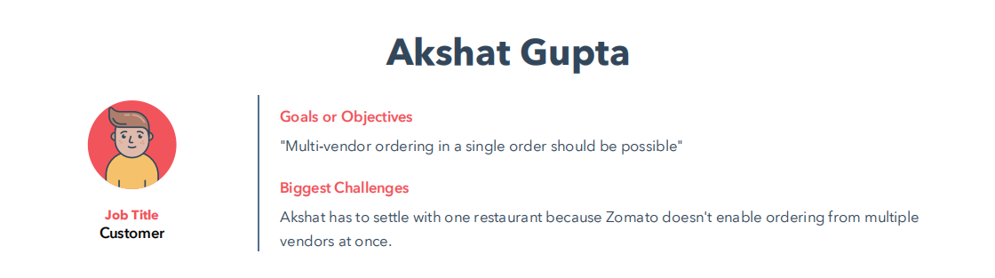
DESIGN THINKING - PERSONA

Slide 4
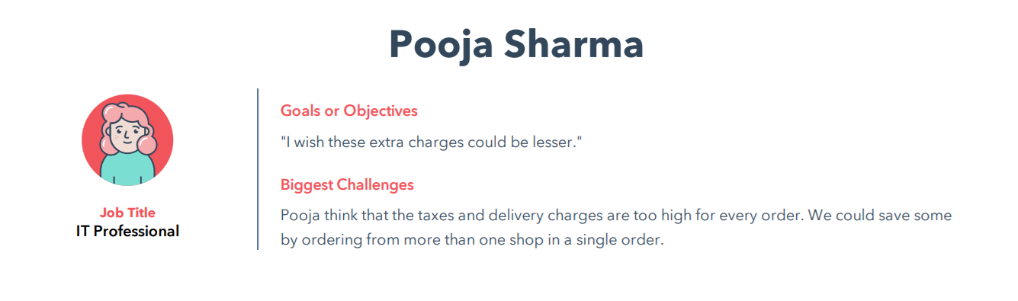
DESIGN THINKING - PERSONA

Slide 5
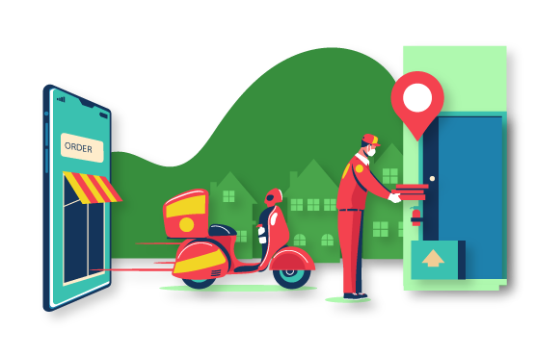
PROBLEM STATEMENT
Food ordering apps (for example Zomato, Swiggy, Uber Eats) are a new normal nowadays.
Although people order extensively from these apps, there’s one problem that customers generally face.
If someone wants to order food from multiple restaurants/vendors, then they have to place separate orders, which are further allotted to different delivery people.
The dishes ordered could be best experienced when eaten together and if the orders arrive at separate times, it is quite frustrating.
Adding fuel to fire, people have to pay separate delivery charges + tax for each order.

Slide 6
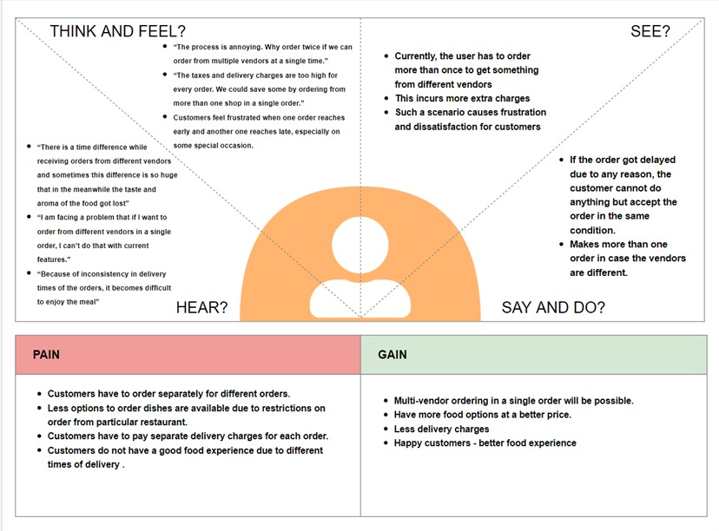
DESIGN THINKING - EMPATHISE

Slide 7
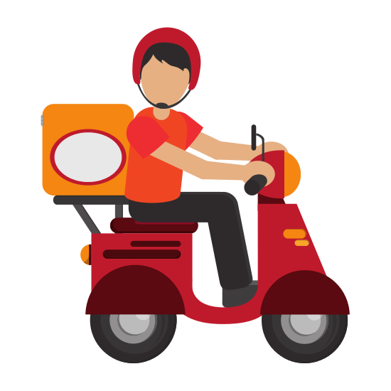
DESIGN THINKING - DEFINE
Most of the food offering apps like Zomato enable us to order food from only one vendor per order. With this solution we aim to solve the problem of multi vendor ordering at one go.
To be precise, we want to help improve the food ordering experience of users by:
Enabling them to order from multiple restaurants and having the food reach to them, all at once.
Reduce multiple delivery charges applied by Zomato and restaurants by reducing the no. of delivery persons involved

Slide 8
DESIGN THINKING - IDEATE
Idea 1: A single delivery guy takes orders from all the vendors specified by a single customer
Pros
Cons
Idea 2: One delivery guy for each vendor specified by a customer
Pros
Cons
Dedicated service to the customer
Beneficial if the vendors are located nearby
Quality of food will be compromised
Reduces the efficiency in delivery
Faster delivery as compared to Idea 1
Improved efficiency in delivery
Async between delivery times
The delivery charges would be more

Slide 9
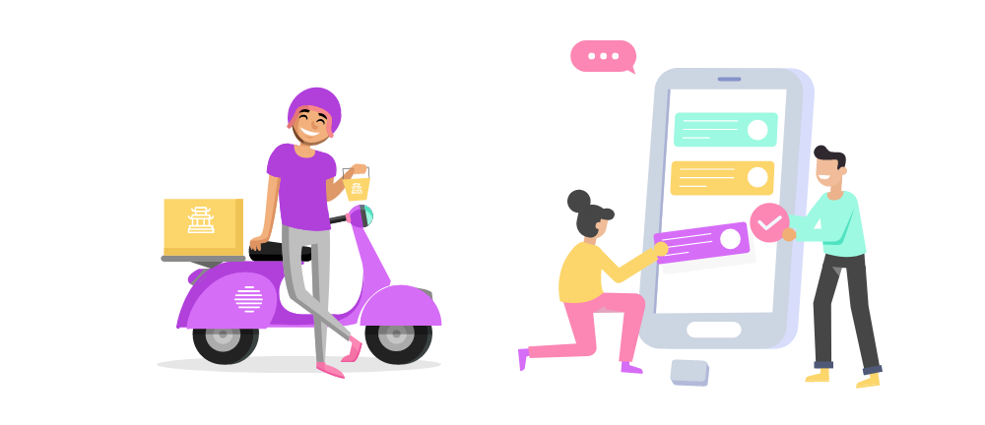
PROPOSED SOLUTION
The proposed solution is to add a feature to allow a customer to order from multiple vendors in a single order.
Depending on the locations of the vendors, one or more delivery persons can be assigned the order and one meeting point will be created from where one of those will take the order to the respective customer.
This would reduce the inconsistency in the delivery of food items, besides saving the customer the extra charges incurred per order.

Slide 10
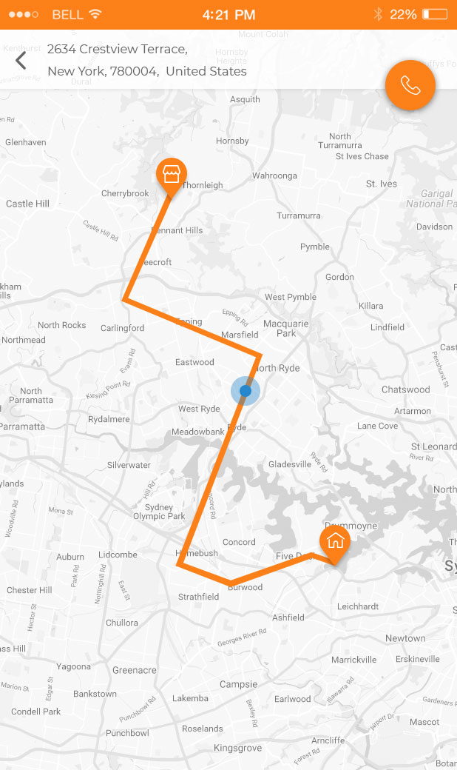
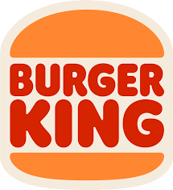
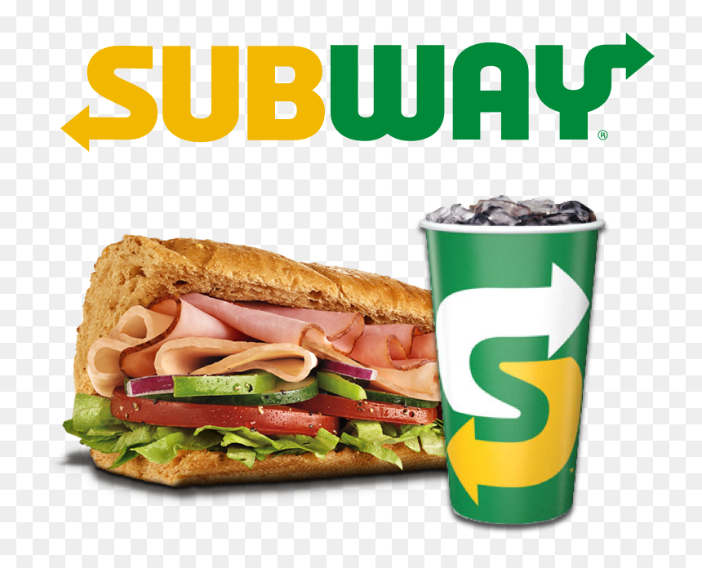

Meeting Point
Common Path covered by single Delivery Boy

Slide 11

Thank you

